Slide 1
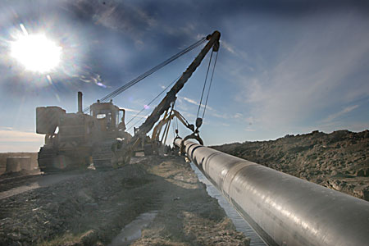
Report on the activity
of Beineu-Shymkent Gas Pipeline LLP on transportation of commercial gas via the main gas pipeline for 2015

Slide 2
General information on the Project
Beineu-Shymkent Gas Pipeline LLP (hereinafter – the Partnership) was registered on January 18, 2011.
The Partnership was established for the purposes of engineering, construction and operation of the gas pipeline on the route Beineu-Bozoy-Shymkent.
The Partnership Shareholders are 50% KazTransGas JSC and 50% Chinese company Trans-Asia Gas Pipeline Co Ltd.
The Gas Pipeline construction project is being implemented within the frames of the Agreement between the Government of RK and the Government of the People’s Republic of China on cooperation in construction and operation of Kazakhstan-China Gas Pipeline dated August 18, 2007 ratified by RK Law No.218-IV dated December 4, 2009, with consideration of amendments and supplements introduced by the Minutes dated October 14, 2009 between the Government of RK and the Government of the People’s Republic of China on introduction of amendments and supplements to the Agreement ratified by RK Law No.330-IV dated July 15, 2010.

Slide 3
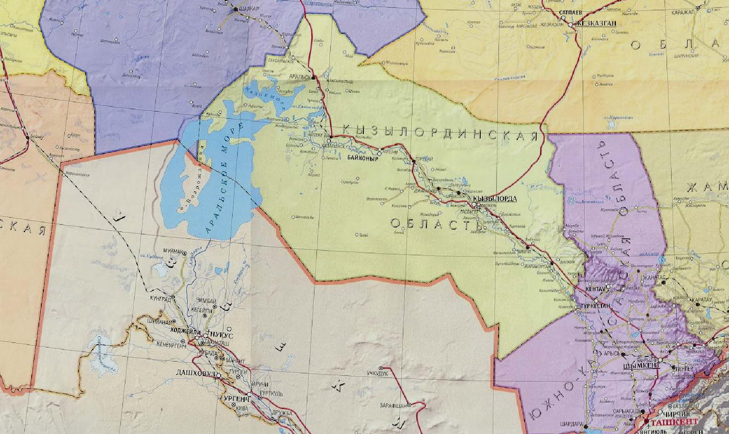
Beineu-Bozoy-Shymkent gas pipeline route
А К Т Ю Б И Н С К А Я
О Б Л А С Т Ь
The first phase. Bozoy-Shymkent section:
Throughput capacity – up to 6 BCMA.
Linear part length – 1143 km.
Diameter – 1067 mm.
Design pressure – 9,8 MPa.
Bozoy compressor station – 5 units.
Emergency-response centers – 4 pcs.
Shift camps – 5 pcs.
Gas metering stations – 2 pcs.
Saksaulsk ERC/SC
Bozoy GMS
Bozoy CS
Bozoy SC
Aksuat ERC/SC
Beineu GMS
Karaozek CS
Karaozek ERC/SC
М А Н Г И С Т А У С К А Я
О Б Л А С Т Ь
Shornak ERC/SC
2 phase. Beineu-Bozoy section:
Increase of the throughput capacity – up to 10 BCMA.
Linear part length – 311 km.
Diameter – 1067 mm.
Design pressure – 7,4 MPa.
Karaozek compressor station – 3 units.
Gas metering station – 1 pcs.
Akbulak GMS

Slide 4
Technical parameters of the gas pipeline
Title | UoM | Value
Gas Pipeline length | km | 1 454
Diameter of the laid pipes | mm | 1067
Diameter of the laid pipes | pcs. | 2
Quantity of gas turbine units | pcs. | 8
Quantity of shift camps | pcs. | 5
Quantity of emergency-response centers | pcs. | 4
Design pressure at Beineu-Bozoy section | МPа | 7,4
Design pressure at Bozoy-Shymkent section | МPа | 9,8
Purpose of the project
Provision of natural gas to RK South regions and gas export to China, increase of energy safety of RK.
Resource base of the project
West and Aktobe groups of fields
Place of the project realization
Mangistau, Aktobe, Kyzylorda and South-Kazakhstan oblasts

Slide 5
Execution of investment program for 2015
Execution of the investment program of the Partnership with regard to adjustments (hereinafter – IP) for 2015 approved by the authorized body department amounts to:
thous. KZT
Ser. No. | Item title | Approved IP with regard to adjustment for 2015 | Actual execution of IP for 2015
 | Total | 23 702 960 | 23 702 960
1 | Construction of MGP linear part at Beineu-Bozoy section (0-311 km) | 22 182 289 | 22 182 289
2 | Construction of Aksuat, Shornak, Saksaulsk, Karaozek ERC | 1 018 566 | 1 018 566
3 | Construction of Aksuat, Shornak, Saksaulsk, Karaozek, Bozoy SC | 444 452 | 444 452
4 | Designer supervision | 57 652 | 57 652

Slide 6
On the main financial and economic indexes of the Partnership activity for 2015
Thous. KZT
Title | Actual for 2015
Income from the core activity | 14 305 380
Income from the non-core activity | 522 446
Expenses | 197 409 327
Production expenses | 11 194 594
Administrative expenses | 5 999 777
Financial expenses | 5 444 889
Other expenses from the non-core activity | 174 770 067
Financial result prior to taxation | - 182 581 501
Corporate income tax | 0
Net income/loss | - 182 581 501
The main reason of the negative financial and economic index of the Partnership is devaluation of the national currency, as well as deviation of the actual indexes from the planned volume of commercial gas transportation.

Slide 7
Information on scopes of rendered regulated services for 2015
For the period of 2015, the Partnership has realized natural gas transportation via main gas pipeline in the volume of 1 215 926 thous. m3:
No. | Title | UoM | In the effective tariff estimate | Actual execution
1 | Commercial gas transportation volume via main gas pipeline | thous. m3 | 2 500 000 | 1 215 926
2 | Gas for own demands and process losses | thous. m3 | 36 163 | 18 838

Slide 8
Information on performed work with consumers of regulated services for 2015
The Partnership has realized in the reporting period:
conclusion of contract on gas transportation via main gas pipeline with commercial gas consumer, in accordance with standard form contract, approved by the Republic of Kazakhstan Government;
carrying out of hearing of annual report on its activity for 2014 in accordance with sub-item 7-3) article 7 of the RK Law “On natural monopolies and regulated markets” and Rules for carrying out of annual report on activity of natural monopoly entity for provision of regulated services (goods, works) to consumers and other concerned persons, approved by the Order of the RK Ministry of National Economy dated December 18, 2014 No.150;
timely communication of consumer concerning change of threshold level of tariff;
there were no complaints from the consumer concerning quality of provided services for gas transportation via main gas pipeline.

Slide 9
Information on item-by-item execution of tariff estimate for 2015
Since June 1, 2014, the Partnership is using the tariff, approved in the simplified procedure to the amount of 11, 765 KZT per one thousand.m3 excluding VAT (approved by the order of the Agency for regulation of natural monopolies of the Republic of Kazakhstan dated May 11, 2014 No.101-ОД).
Tables, which reflect execution of effective tariff estimate for commercial gas transportation via main gas pipeline of the Partnership for 2015, are stated below:
No. | Title | UoM | In effective tariff estimate | Actual execution
I | Costs for manufacture of goods and provision of services: | thous. KZT | 11 396 138 | 11 186 706
II | Period expenses, total: |  | 2 503 297 | 6 901 902
III | Total costs | thous. KZT | 13 899 435 | 18 088 608
IV | Profit | thous. KZT | 15 513 065 | -3 783 228
V | Total income | thous. KZT | 29 412 500 | 14 305 380
VI | Rendered services scope | thous. m3 | 2 500 000 | 1 215 926
VIII | Tariff | KZT/thous. m3 | 11 765 | 11 765

Slide 10
Tariff estimate execution on gas transportation for 2015
Seq.No. | Title of indicators | UoM | In effective tariff estimate | Actual costs for 2015 | Deviation in %
1 | 2 | 3 | 4 | 5 | 6
I | Costs for manufacture of goods and provision of services: | thous.KZT | 11 396 138 | 11 186 706 | 98%
1 | Material expenses, total | -//- | 339 349 | 110 098 | 32%
 | including:
1.1 | gas for own demands and process losses | -//- | 331 982 | 104 350 | 31%
1.2 | Electric energy | -//- | 2 935 | 0 | 0%
1.3 | Fuel (POL) | -//- | 4 431 | 5 748 | 130%
2 | Costs for labor remuneration, total | -//- | 63 901 | 61 269 | 96%
 | including:
2.1 | Salary | -//- | 58 144 | 56 757 | 98%
2.2 | Social tax | -//- | 5 756 | 4 512 | 78%
3 | Depreciation | -//- | 8 347 560 | 9 491 532 | 114%
4 | Insurance | -//- | 4 677 | 113 702 | 2431%
5 | Costs for gas pipeline operation | -//- | 2 110 926 | 1 140 007 | 54%
6 | Taxes and payments | -//- | 4 625 | 1 437 | 31%
7 | Other costs, total | -//- | 517 700 | 240 677 | 46%
 | including:
7.1 | Air patrolling | -//- | 238 457 | 65 332 | 27%
7.2 | Verification of measuring equipment | -//- | 6 314 | 0 | 0%
7.3 | Gas pipeline security | -//- | 185 431 | 169 911 | 92%
7.4 | Fire alarm system maintenance | -//- | 87 497 | 0 | 0%
7.5 | Business trip expenses | -//- | - | 3 115
7.6 | Services of satellite communication and connection to telecommunications system | -//- | - | 2 320
8 | Other expenses | -//- | 7 401 | 27 983 | 378%
8.1 | Announcement in mass-media on gas pipeline route | -//- | 1 607 | 3 533 | 220%
8.2 | Rent of premises | -//- | 3 782 | 4 106 | 109%
8.3 | Expenses for motor vehicles | -//- | 2 012 | 3 511 | 174%
8.4 | Expenses for ground in a period of main gas pipeline operation | -//- | - | 4 210
8.5 | Services of auxiliary personnel | -//- | - | 12 625

Slide 11
Tariff estimate execution on gas transportation for 2015
Seq.No. | Title of indicators | UoM | In the effective tariff estimate | Actual expenses for 2015 | Deviation in %
1 | 2 | 3 | 4 | 5 | 6
II | Expenses of the period, total: | -//- | 2 503 297 | 6 901 902 | 276%
9 | General and administrative expenses, total | -//- | 967 211 | 1 457 014 | 151%
 | including:
9.1 | Salary of administrative personnel | -//- | 490 221 | 836 356 | 171%
9.2 | engaged personnel | -//- | 49 892 | 76 346 | 153%
9.3 | Social tax | -//- | 48 532 | 78 274 | 161%
9.4 | depreciation | -//- | 45 613 | 54 540 | 120%
9.5 | offices rent | -//- | 155 737 | 147 999 | 95%
9.6 | third companies services | -//- | 18 985 | 22 092 | 116%
9.7 | business trip services | -//- | 68 474 | 98 452 | 144%
9.8 | banks services | -//- | 6 974 | 7 517 | 108%
9.9 | audit companies services | -//- | 15 050 | 23 075 | 153%
9.10 | Office security | -//- | 10 202 | 7 209 | 71%
9.11 | taxes | -//- | 1 294 | 20 239 | 1564%
9.12 | communication services | -//- | 14 729 | 10 147 | 69%
9.13 | transport expenses | -//- | 23 376 | 28 615 | 122%
9.14 | insurance | -//- | 1 165 | 3 928 | 337%
9.15 | staff training | -//- | 6 233 | 8 107 | 130%
9.16 | other expenses | -//- | 0
9.17 | other expenses | -//- | 10 736 | 34 117 | 318%
10 | expenses for incentives payment |  | 1 536 086 | 5 444 888 | 354%
III | Total costs | -//- | 13 899 435 | 18 088 608
IV | Income | -//- | 15 513 065 | - 3 783 228
V | Total income | -//- | 29 412 500 | 14 305 380
VI | Scope of rendered services | thous. m3 | 2 500 000 | 1 215 926
VII | Normative losses | % | 1,45 | -
 |  | 1000 m3 | 36 164 | -
VIII | Tariff (excluding VAT) | KZT/ 1000 m3 | 11 765 | 11 765

Slide 12
Main causes of deviation on tariff estimate execution
Saving has been provided by:
Reduction in gas cost for own demands and process losses (hereinafter – OD&PL).
The cost for purchase of gas for own demands and process losses has been planned in the effective tariff estimate to the amount of 9 180 KZT excluding VAT per one thous.m3, and actual cost of gas from January 1st to August 31st made 5 598,6 KZT per one thous.m3 excluding VAT and from September 1st to December 31st - 5 696,1 KZT per one thous.m3 excluding VAT;
Reduction in consumption volume of gas for OD&PL.
Consumption volume of gas for own demands and process losses has been planned based on gas transportation volume to the amount of 2 500 000 thous. m3, actual gas transportation volume for 2015 made 1 215 926 thous.m3;
Untimely commissioning of emergency response centers and shift camps.
There was no need in expenses for electric energy, security, maintenance of fire alarm system and etc.;
Reduction in costs for gas pipeline operation.
Main reason is untimely conclusion of contracts with outside companies and non-execution by contractors of key performance indicators.
Excess has been provided by:
Implementation of new monetary policy based on inflation targeting mode, and transition to fully flexible exchange rate of KZT
At consideration of request in the simplified procedure by the authorized agency, certain costs items haven’t been considered;
Cost increase of goods, works and services.

Slide 13
Future activity (development plan), probable change of tariff for regulated service for commercial gas transportation
Future activity (development plan)
1. The Partnership is intended to complete the construction of Beineu-Bozoy-Shymkent Main Gas Pipeline in 2017 and increase design capacity of Beineu-Bozoy-Shymkent Main Gas Pipeline up to 10 bln. m3 per year under the execution of the Agreement between the RK Government and Government of Peoples’ Republic of China on cooperation in construction and operation of Kazakhstan-China Gas Pipeline dated August 18, 2007, ratified by the RK Law dated December 4, 2009 No.218-IV, taking into consideration amendments and supplements, introduced by the Minutes of meeting dated October 14, 2009 between the RK Government and Government of Peoples’ Republic of China on introduction of amendments and supplements to the Agreement, ratified by the RK Law dated July 15, 2010 No.330-IV.
2. One of basic directions of the Partnership activity is assurance for reliable and safe transportation of natural gas. The Partnership should transport the supplied gas volumes, and situations dangerous for humans and environment should not be allowed, at that having provided optimal indicators of production and economic activity. During the period of projects implementation, the Partnership is intended:
a) to maintain the set level of natural gas transportation
b) to ensure lack of accidents at the gas pipeline facilities, emergency situation, which entails stoppage in production and causing of environmental damage
c) to increase the gas pipeline operation efficiency
d) to increase efficiency of use of energy resources (process gas, electric energy, water and etc.)
e) to ensure supporting of high performance efficiency and advanced training of personnel.
Probable change of tariff for regulated service for gas transportation
Almaty City Department of the Committee for regulation of natural monopolies and competition protection of the RK Ministry of National Economy has approved the threshold level of tariff and tariff estimate for regulated service for commercial gas transportation via main gas pipeline for 2015-2019 to the amount of 18 071 KZT per 1000 m3 excluding VAT, with putting into effect since March 1, 2016.

Slide 14
Thank you for
your attention!

