Slide 1
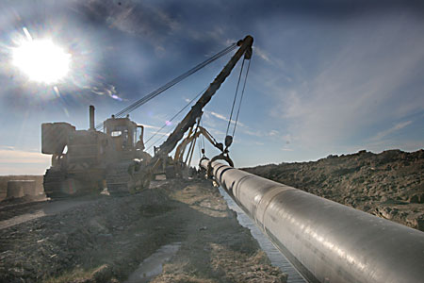
Annual report on activity of
Beineu-Shymkent Gas Pipeline LLP
as related to commercial gas transportation
via main gas pipeline for 2017

Slide 2
General information on the Project
Project goal:
Providing natural gas to the southern regions of the RK, exporting supply of gas to China, ensuring the energy security of the Republic of Kazakhstan.
The Project participants:
The Agreement between the Government of the Republic of Kazakhstan and Government of People’s Republic of China on cooperation in construction and operation of the Kazakhstan-China Gas Pipeline has been signed on August 18,2007
On January 18, 2011 KazTransGas JSC (50%) and Trans-Asia Gas Pipeline Co Ltd (50%) established Beineu-Shymkent Gas Pipeline LLP (hereinafter - the Partnership).
Resource base of the Project:
Western and Aktyubinsk group of fields
Project realization place:
Mangistau, Aktyubinsk, Kyzylorda and South-Kazakhstan oblasts.

Slide 3
Technical parameters of the gas pipeline
Title | UoM | Value
Gas pipeline length | km | 1 454
Diameter of laid pipes | mm | 1067
Compressor stations | units | 2
Shift Camps | units | 5
Emergency-response centers | units | 4
Design pressure on Beineu-Bozoy section | MPa | 7,4
Design pressure on Bozoy -Shymkent section | MPa | 9,8
Potential number of GDS to be connected to BBS MGP | units | 26
Potential number of settlements subject to gasification | units | 529

Slide 4
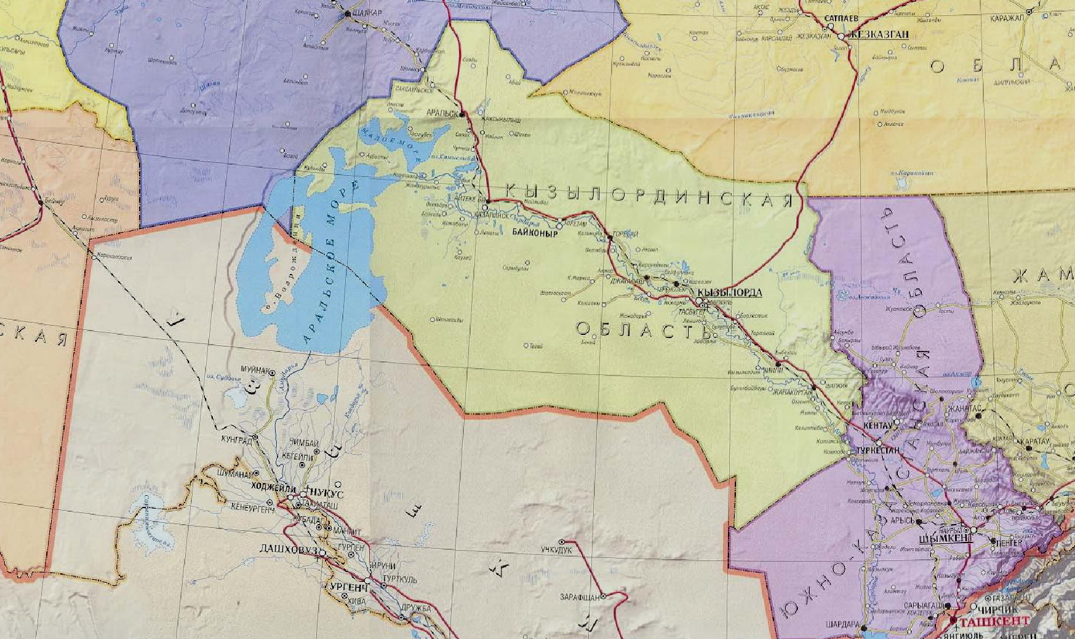
Beineu-Bozoy-Shymkent Gas Pipeline Diagram
AKTYUBINSK
OBLAST
Phase 1 Bozoy-Shymkent section:
Throughput capacity - up to 6 bln.m3/year
Linear part length – 1143 km.
Diameter - 1067 mm;
Design pressure - 9.8 МPa;
Bozoy compressor station – 5 units.
Emergency-response centers– 4 units.
Shift camps – 5 units.
Gas-metering stations - 2 units
Saksaulsk ERC/SC
Bozoy GMS
Bozoy CS
Bozoy SC
Aksuat ERC/SC
Beineu GMS
Karaozek CS
Karaozek ERC/SC
MANGISTAU
OBLAST
Shornak ERC/SC
Phase 2 Beineu-Bozoy section:
Increase of throughput capacity - up to 10 bln.m3/year
Linear part length – 311 km.
Diameter - 1067 mm;
Design pressure - 7,4 МPa.
Karaozek CS compressor station – 3 units.
Gas-metering station - 1 unit
Akbulak GMS

Slide 5
On work performed with consumers of regulated services for 2017
During the reporting period the Partnership has performed:
The conclusion of the contract for the transportation of gas via the main gas pipeline with a consumer of the regulated service, in accordance with the standard contract;
Holding a hearing of the annual report on its activities for 2016, in accordance with sub-item 7-3) of Article 7 of the Law of the Republic of Kazakhstan "On Natural Monopolies and Regulated Markets" and the Rules for performance of the Annual Report on the Activity of the Natural Monopoly Entity on the Provision of Regulated Services (Goods, Works) toward consumers and other interested parties, approved by the Order of the Minister of National Economy of the Republic of Kazakhstan dated December 18, 2014 No. 150;
Complaints on the quality of the services provided for the transportation of gas via the main gas pipeline were not received from the consumer.

Slide 6
Scopes of provided regulated services for 2017
Ser.No. | Title | UoM | In the approved tariff estimate | Actual execution
1 | Scope of commercial gas transportation via the main gas pipeline | thous.m3 | 5 000 000 | 4 376 993
2 | Gas for own demands and losses | thous.m3 | 78 260 | 30 052
Tariff to the amount of 18 071 KZT/thous.m3 has been applied since 01.03.2016.

Slide 7
Financial and economic indicators for 2017
thous.KZT
Title | Fact for 2017
Income from core activity | 79 096 648
Net cost for services rendering | (16 264 208)
Gross revenue | 62 832 440
General and administrative expenses | (1 945 492)
Income (loss) from exchange rate difference, netto | 1 549 048
Financial expenses | (24 649 158)
Other income (loss) | (283 670)
Net income (loss) before taxation | 38 070 508
Costs under income tax | 0
Net income (loss) after taxation | 38 070 508

Slide 8
Execution of the Investment program for 2017
The investment program, taking into consideration the adjustments has been approved by the joint order of the Ministry of Energy of the Republic of Kazakhstan dated November 23, 2017 No. 399 and the Department of the Committee for Regulation of Natural Monopolies, Competition Protection and consumers rights of the Ministry of National Economy of the Republic of Kazakhstan of Almaty dated November 3, 2017 No. 96-OД.
thous. KZT excluding VAT
Ser.No. | Item title | Approved investment program for 2017 | Actual execution of the investment program for 2017 | Deviation, in %
 | Total | 10 788 908 | 13 448 036 | 125%
1 | Construction of Bozoy compressor station (5 GTUs with a unit capacity of 1020 kW) | 6 952 200 | 8 115 599 | 117%
2 | Construction of shift camps (Aksuat, Shornak, Saksaulsk, Karaozek, Bozoy) | 1 039 896 | 1 114 999 | 107%
3 | Implementation of telemetry and automation system of the commercial gas metering unit “SCADA” | 2 739 951 | 4 029 467 | 147%
4 | Designer supervision | 56 860 | 42 187 | 74%
5 | Construction of emergency-response centers (Aksuat, Shornak, Saksaulsk, Karaozek) | 0 | 15 054
6 | Construction of the along route road transport bed at the section of Beineu-Bozoy | 0 | 130,730

Slide 9
Execution of the tariff estimate for 2017
Ser.No. | Title | UoM | Acting Tariff estimate | Actual execution** | Deviation, in %
I | Cost of production goods and services | thous. KZT | 23 265 784 | 16 551 205 | 71%
II | Costs for the period total: | thous. KZT | 4 611 704 | 10 738 567 | 233%
III | Total expenses | thous. KZT | 27 877 488 | 27 289 771 | 98%
IV | Profit | thous. KZT | 51 995 614 | 51 806 877 | 100%
V | Total incomes | thous. KZT | 79 873 102 | 79 096 648 | 99%
VI | Scope of provided services | thous. m³ | 5 000 000 | 4 376 993 | 88%
VIII | Tariff | tenge/ 1000 m³ | 15 975* | 18,071 | 113%
* - the average tariff for 2015-2019 is 18,071 KZT per 1000 m3 excluding VAT;
** - formed according to operational data.

Slide 10
Clause-by-clause execution by the approved agency of
the authorized body of the tariff estimate for 2017
Ser.No. | Indicators title | UoM | Approved TE taking into account the adjustments | Actual execution for 2017 | Relative deviation, in %
1 | 2 | 3 | 4 | 5 | 6
I | Costs for production of goods and provision of services including: | thous.KZT | 23 265 784 | 16 551 205 | 71%
1 | Financial costs, including: | -//- | 586 161 | 218 859 | 37%
1.1 | Gas for own demands and losses | -//- | 520 052 | 206 085 | 40%
1.2 | POL (Generator and motor vehicle) | -//- | 66,109 | 12 773 | 19%
1.3 | Electric power | -//-
2 | Labor payment expenses, including: | -//- | 221 070 | 117 308 | 53%
2.1 | Salary of production personnel | -//- | 201 155 | 109 034 | 54%
2.2 | Social tax | -//- | 19 914 | 8 275 | 42%
3 | Depreciation | -//- | 15 449 970 | 12 567 042 | 81%
4 | Insurance | -//- | 290 534 | 442 696 | 152%
5 | Gas pipeline operation costs | -//- | 5 787 415 | 2 511 199 | 43%
6 | Taxes and payments | -//- | 288 | 284 | 99%
7 | Other expenses, including: | -//- | 733 975 | 624 913 | 85%
7.1 | Aerial surveillance | -//- | 125 024 | 31 920 | 26%
7.2 | Verification of measuring instruments (metrology and standardization services) | -//- | 18 261 | 83 250 | 456%
7.3 | Gas pipeline security (extradepartmental and fire security) | -//- | 458 731 | 486 025 | 106%
7.4 | Business trip expenses | -//- | 130 914 | 7 761 | 6%
7.5 | Satellite communication and connection to telecommunication system | -//- |  | 14 906
7.6 | Personnel training | -//- | 1 044 | 1 050 | 101%
8 | Other expenses | -//- | 196 372 | 68 904 | 35%

Slide 11
Clause-by-clause execution by the approved agency of
the authorized body of the tariff estimate for 2017
Ser.No. | Indicators title | UoM | Approved TE taking into account the adjustments | Actual execution for 2017 | Relative deviation, in %
1 | 2 | 3 | 4 | 5 | 6
II | Period expenses, including: | -//- | 4 611 704 | 10 738 567 | 233%
9 | General and administrative expenses, including: | -//- | 1 007 204 | 1 700 446 | 169%
9.1 | Salary of Administrative personnel | -//- | 499 621 | 1 042 244 | 209%
9.3 | Social tax | -//- | 49 462 | 99 184 | 201%
9.2 | Hired personnel (recruiting expenses) | -//- | 0 | 77 895
9.4 | Depreciation | -//- | 80,936 | 43 488 | 54%
9.5 | Expenses for the office lease, including maintenance | -//- | 149 889 | 138 179 | 92%
9.6 | Services of third party companies | -//- | 28 195 | 22,615 | 80%
9.7 | Business trips related services | -//- | 69 115 | 124,112 | 180%
9.8 | Banks services | -//- | 12,000 | 6 547 | 55%
9.9 | Services of audit companies | -//- | 35 492 | 26 650 | 75%
9.10 | Office security | -//- | 10 810 | 6 718 | 62%
9.11 | Taxes | -//- | 1,383 | 15 008 | 1085%
9.12 | Communication services | -//- | 20 115 | 7 752 | 39%
9.13 | Expenses for vehicles | -//- | 34 915 | 29 981 | 86%
9.14 | Insurance | -//- | 1 111 | 25 342 | 2281%
9.15 | Personnel training | -//- | 1 044 | 7 617 | 729%
9.16 | Other expenses | -//- | 13 116 | 27 117 | 207%
10 | Incentive payment cost | -//- | 3 604 500 | 9 038 121 | 251%
III | Total expenses for services rendering | -//- | 27 877 488 | 27 289 771 | 98%
IV | Profit (RBA*SP) | -//- | 51 995 614 | 51 813 959 | 100%
VI | Total incomes | -//- | 79 873 102 | 79 103 730 | 99%
VII | Scope of services (goods, works) to be rendered | thous.m3 | 5 000 000 | 4 377 385 | 88%
VIII | Tariff (excluding VAT) | tenge/ 1000 m³ | 15,975 | 18,071

Slide 12
The main reasons of the deviation as related to the implementation of the tariff estimate
The total costs for provision of services in the Approved Tariff Estimate make - 27,877, 488 thous. KZT excluding VAT, the actual performance makes 27, 289, 771 thous. KZT excluding VAT or 98%, including:
Costs for the production of goods and services: the plan for the Tariff estimate makes 23, 265, 784 thous. KZT excluding VAT, the actual execution - 16, 551,205 thous. KZT excluding VAT or 71%.
Period expenses: the plan for the TE makes 4, 611,704 thous. KZT excluding VAT, the actual execution is 10, 738, 567 thous. KZT excluding VAT or 233%.
The saving under the costs for production of goods and provision of services is provided by:
transfer of the dates of commissioning of some production facilities;
conclusion of contracts for smaller amounts;
savings under results of tenders.
For the period expenditures, the over expenditure is provided by:
not all costs associated with the Salary fund have been included into the tariff estimate;
increase in expenses for financing due to the devaluation of the national currency against the US dollar.

Slide 13
Prospects of activity (development plan), possible change in the tariff for commercial gas transportation service:
Prospects of activity (development plan)
ensuring reliable and safe transportation of commercial gas;
ensuring the established level of transportation of commercial gas;
to ensure the absence of accidents at the gas pipeline facilities, emergency situations that caused the suspension of the production and cause environmental damage;
to increase the efficiency of the gas pipeline operation;
to increase the efficiency of the use of energy resources (process gas, electricity, water, etc.);
to ensure the maintenance of high labor productivity and advanced training of the staff.
consideration of the possibility for increasing the throughput capacity of the main gas pipeline up to 15 bln. m3 per year.
Possible change in the tariff for a regulated gas transportation service
Almaty Department of the Committee for Regulation of Natural Monopolies and Protection of Competition of the Ministry of National Economy of the Republic of Kazakhstan approved the threshold level of tariff and tariff estimate for regulated service for transportation of commercial gas via the main gas pipeline for 2015-2019 to the amount of 18,071 KZT per 1000 m3 excluding VAT putting into effect from March 1, 2016.

Slide 14
Thank you for your attention!

