Slide 1
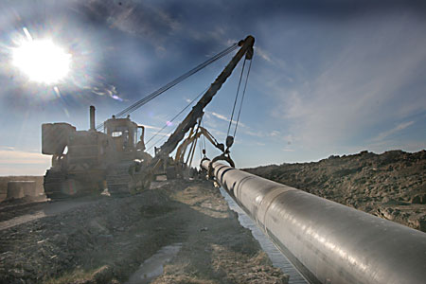
Annual report on activity of
Beineu- Shymkent Gas Pipeline LLP
as related to commercial gas transportation
via main gas pipeline for 2018

Slide 2
General information on the Project
Project goal:
Providing natural gas to the southern regions of the RK, exporting supply of gas to China, ensuring the energy security of the Republic of Kazakhstan.
The Project participants:
The Agreement between the Government of RK and Government of the People’s Republic of China on cooperation in construction and operation of the Kazakhstan-China Gas Pipeline 2007 was signed on August 18,2007.
On January 18, 2011 KazTransGas JSC (50%) and Trans-Asia Gas Pipeline Co Ltd (50%) established Beineu-Shymkent Gas Pipeline LLP (hereinafter - the Partnership).
Resource base of the Project:
Western and Aktyubinsk group of fields
Project realization place:
Mangistau, Aktobe, Kyzylorda and Turkestan oblasts.

Slide 3
Achievements and milestones for 2018
In January 2018 the acts of final acceptance for construction of linear part for the Phases 1 and 2 under EPC contracts with KazStroyService OGCC JSC and CPPLB Kazakhstan JSC were signed.
In September 2018 the act of final acceptance of Bozoy CS and SC under the EPC contract has been signed with Daughter Company of China Petroleum Engineering and Construction Corporation LLP;
Design institutions KING JSC and CPPE developed the FS “Increase of BBS MGP throughput capacity up to 15 BCMA” in accordance with the trilateral agreement No.2018/BSGP/PMT-122, signed on September 24, 2018 between the Partnership, KING JSC and CPPE;
The Technical assignment for design (Basic Design) of Beineu-Bozoy-Shymkent gas pipeline construction Project. Phase 3. “Increase of the throughput capacity of BBS MGP up to 15 BCMA” was developed and forwarded for agreement to the Partnership Founders;
The Principle debt was prepaid to CDB - 53 mln. US dollars.
The Principle debt and loan interests were prepaid to KTG- 8 536 mln. KZT (Principle debt - 4 239 mln. KZT and % - 4 297 mln. KZT);

Slide 4
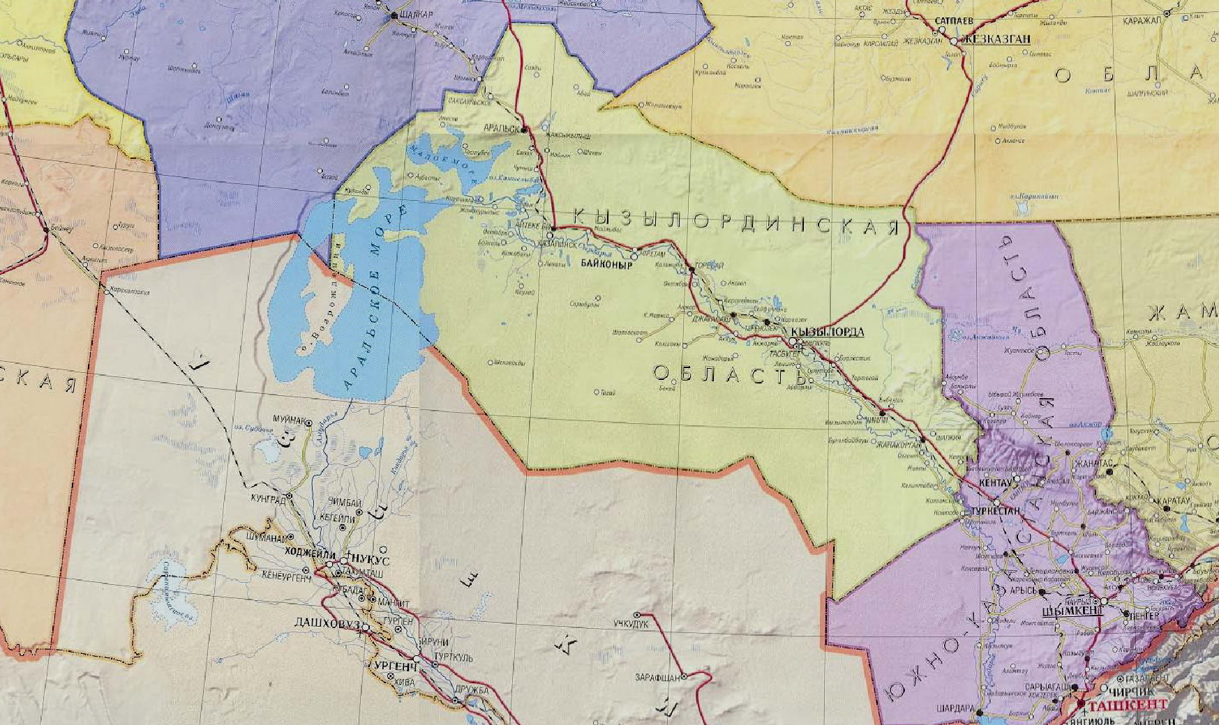
Beineu-Bozoy-Shymkent Gas Pipeline Diagram
AKTOBE
OBLAST
Phase 1 Bozoy-Shymkent section:
Throughput capacity - up to 6 bln.m3/year
Linear part length – 1143 km.
Diameter - 1067 mm;
Design pressure - 9.8 МPa;
Bozoy compressor station – 5 units.
Emergency-response centers– 4 units.
Shift camps – 5 units.
Gas-metering stations - 2 units
Saksaulsk ERC/SC
Bozoy GMS
Bozoy CS
Bozoy SC
Aksuat ERC/SC
Beineu GMS
Karaozek CS
Karaozek ERC/SC
MANGISTAU
OBLAST
Shornak ERC/SC
Phase 2 Beineu-Bozoy section:
Increase of throughput capacity - up to 10 bln.m3/year
Linear part length – 311 km.
Diameter - 1067 mm;
Design pressure - 7,4 МPa.
Karaozek CS compressor station – 3 units.
Gas-metering station - 1 unit
Akbulak GMS

Slide 5
On the work performed with consumers of regulated services for 2018
During the reporting period the Partnership has performed:
Holding a hearing of the annual report on its activities for 2017, in accordance with sub-item 7-3) of Article 7 of the Law of the Republic of Kazakhstan "On Natural Monopolies and Regulated Markets" and the Rules for performance of the Annual Report on the Activity of the Natural Monopoly Entity on the Provision of Regulated Services (Goods, Works) toward consumers and other interested parties, approved by the Order of the Minister of National Economy of the Republic of Kazakhstan dated December 18, 2014 No. 150;
Complaints on the quality of the services provided for the transportation of gas via the main gas pipeline were not received from the consumer.

Slide 6
Scopes of provided regulated services for 2018
Mln m3 KZT/thous.m3
Seq.No. | Title | UoM | In the approved tariff estimate | Actual execution
1 | Scope of commercial gas transportation via the main gas pipeline | thous.m3 | 5 803 352 | 8 352 048
2 | Gas for own demands and losses | thous.m3 | 706 951 | 747 683
Tariff in the amount of 18 071 KZT/ thous.m3 was introduced since 01.03.2016

Slide 7
Execution of the investment program for 2018
The investment program, taking into consideration the adjustments has been approved by the joint order of the Ministry of Energy of the Republic of Kazakhstan dated December 11, 2018, No. 501 and Almaty Department of the Committee for regulation of natural monopolies, protection of competition and consumers' rights at the Ministry of National Economy dated November 14, 2018, No. 227-OД.
thous.KZT excluding VAT
Seq.No. | Item name | Approved IP for 2018 | Actual execution of IP for 2018 | Deviation, in %
 | Total | 8 113 801 | 8 842 189 | 109%
1 | Construction of emergency-response centers (Aksuat, Shornak, Saksaulsk, Karaozek) | 2 154 473 | 2 154 473 | 100%
2 | Construction of shift camps (Aksuat, Shornak, Saksaulsk, Karaozek, Bozoy) | 831 646 | 831 646 | 100%
3 | Construction of Beineu gas metering station | 299 571 | 290 743 | 97%
4 | Construction of the along route road transport bed at the section of Beineu-Bozoy | 1 259 300 | 1 490 677 | 118%
5 | Implementation of telemetry and automation system of the commercial gas metering unit "SCADA" | 3 527 538 | 4 033 059 | 114%
6 | Designer supervision | 41 272 | 41 590 | 101%

Slide 8
Execution of the tariff estimate for 2018
Seq.No. | Title | UoM | Acting Tariff estimate | Actual execution | Deviation, in %
I | Expenses for goods manufacturing and services rendering: | thous.KZT | 24 671 539 | 25 047 354 | 102%
II | Period expenses, total: | thous.KZT | 22 193 019 | 22 906 123 | 103%
III | Total expenses | thous.KZT | 46 864 559 | 47 953 478 | 102%
IV | Profit | thous. KZT | 58 007 815 | 102 976 376 | 178%
V | Total incomes | thous. KZT | 104 872 374 | 150 929 853 | 144%
VI | Scope of rendered services | thous. m³ | 5 803 352 | 8 352 048 | 144%
VIII | Tariff | tenge/ 1000 m³ | 15 975* | 18,071 | 113%
* - the average tariff for 2015-2019 is 18 071 KZT per 1000 m³ excluding VAT;
.

Slide 9
Clause-by-clause execution by the approved agency of
the authorized body of the tariff estimate for 2018
Seq.No. | Indicators title | UoM | Approved TE taking into account the adjustments | Actual execution for 2018 | Relative deviation, in %
1 | 2 | 3 | 4 | 5 | 6
I | Costs for production of goods and provision of services including: | thous.KZT | 24 671 539 | 25 042 065 | 102%
1 | Financial costs, including: | -//- | 714 993 | 756 004 | 106%
1.1 | Gas for own demands and losses | -//- | 706 951 | 747 683 | 107%
1.2 | POL (Generator and motor vehicle) | -//- | 8 042 | 8 321 | 103%
2 | Labor payment expenses, including: | -//- | 79 609 | 80 130 | 102%
2.1 | Salary of production personnel | -//- | 73 339 | 73 819 | 101%
2.2 | Social tax | -//- | 6 270 | 6 132 | 112%
3 | Depreciation | -//- | 16 346 322 | 16 346 313 | 100%
4 | Insurance | -//- | 436 809 | 436 840 | 100%
5 | Gas pipeline operation costs | -//- | 6 127 784 | 6 449 635 | 105%
6 | Taxes and payments | -//- | 277 | 275 | 99%
7 | Other expenses, including: | -//- | 722 370 | 738 571 | 102%
7.1 | Aerial surveillance | -//- | 35 791 | 39 281 | 110%
7.2 | Gas pipeline security (extradepartmental and fire security) | -//- | 596 543 | 596 024 | 100%
7.3 | Business trip expenses | -//- | 13 611 | 13 358 | 98%
7.4 | Satellite communication and connection to telecommunication system | -//- | 74 801 | 88 192 | 118%
7.5 | Personnel training | -//- | 1 625 | 1 715 | 106%
8 | Other expenses | -//- | 243 374 | 234 296 | 96%

Slide 10
Clause-by-clause execution by the approved agency of
the authorized body of the tariff estimate for 2018
Seq.No. | Indicators title | UoM | Approved TE taking into account the adjustments | Actual execution for 2018 | Relative deviation, in %
1 | 2 | 3 | 4 | 5 | 6
II | Period expenses, including: | -//- | 22 193 019 | 22 906 123 | 103%
9 | General and administrative expenses, including: | -//- | 1 225 127 | 1 423 966 | 116%
9.1 | Salary of Administrative personnel | -//- | 534 594 | 596 655 | 96%
9.2 | Social tax | -//- | 52 925 | 50 907 | 112%
9.3 | Depreciation | -//- | 55 022 | 53 959 | 98%
9.4 | Expenses for the office lease, including Content | -//- | 134 392 | 144 387 | 107%
9.5 | Services of third party companies | -//- | 30 605 | 51 025 | 167%
9.6 | Business trips related services | -//- | 106 653 | 131 451 | 123%
9.7 | Banks services | -//- | 7 165 | 7 308 | 102%
9.8 | Services of audit companies | -//- | 33 600 | 33 600 | 100%
9.9 | Office security | -//- | 7 420 | 7 488 | 101%
9.10 | Taxes | -//- | 2 363 | 2 375 | 101%
9.11 | Communication services | -//- | 8 873 | 8 880 | 100%
9.12 | Expenses for vehicles | -//- | 39 776 | 47 502 | 119%
9.13 | Insurance | -//- | 3 389 | 3 280 | 97%
9.14 | Personnel training | -//- | 11 631 | 12 617 | 108%
9.15 | Other expenses | -//- | 41 216 | 43 866 | 106%
10 | Incentive payment cost | -//- | 20 967 892 | 21 482 158 | 102%
III | Total expenses for the services rendering | -//- | 46 864 559 | 47 948 188 | 102%
IV | Profit (RBA*SP) | -//- | 58 007 815 | 102 981 665 | 178%
V | Total incomes | -//- | 104 872 374 | 150 929 853 | 144%
VI | Scope of services (goods, works) to be rendered | thous.m3 | 5 803 352 | 8 352 048 | 144%
VII | Tariff (excluding VAT) | tenge/ 1000 m³ | 15 975 | 18 071

Slide 11
The main reasons for the deviation in the implementation of the tariff estimate
The total expenses for the services rendering in the approved tariff estimate is - 46 864 559 thous. KZT excluding VAT, the actual performance is 47 953 478 thous. KZT excluding VAT or 102%, including:
Costs for the production of goods and services: the plan for TE is 24 671 539 thous. KZT excluding VAT, the actual execution - 25 047 354 thous. KZT excluding VAT or 102%.
Period expense: the plan for the TE is 22 193 019 thous. KZT excluding VAT, the actual execution is 22 906 123 thous KZT excluding VAT or 103%.
Over-execution under the costs for production of goods and services rendering is stipulated by:
Increase of expenses for the services on gas pipeline operation;
Increase of expenses for the services on connection to the satellite communication systems.
As for the period expenses, the over execution is stipulated by:
increase in expenses for financing due to the devaluation of the national currency against the US dollar.

Slide 12
Prospects of activity (development plan), possible change in the tariff for commercial gas transportation service:
Prospects of activity (development plan)
ensuring reliable and safe transportation of commercial gas;
ensuring the established level of transportation of commercial gas;
to ensure the absence of accidents at the gas pipeline facilities, emergency situations that caused the suspension of the production and cause environmental damage;
to increase the efficiency of the gas pipeline operation;
to increase the efficiency of the use of energy resources (process gas, electricity, water, etc.);
to ensure the maintenance of high labor productivity and advanced training of the staff.
To carry out the works on increasing the throughput capacity of the main gas pipeline up to 15 BCMA.
Change of the tariff for the regulated service on gas transportation service
Department of the Committee for Natural Monopolies Regulation and Competition Protection of the Ministry of National Economy of the RK for Almaty approved the threshold level of tariff and tariff estimate for regulated service for transportation of commercial gas via the main gas pipeline for 2015-2019 putting into effect from May 1, 2019 in amount of 16 574 KZT per 1000 cub.m.

Slide 13
Thank you for your attention!

